Slide 1

Fake news detection using machine learning
Presented By
Student Name: Sindhuja ganimukkula
Email ID: ganimukkulasindhuja@gmail.com

Slide 2

OUTLINE
Problem Statement
Proposed System
System Development Approach
Algorithm & Deployment
Result
Handling Misclassification of News
Conclusion
Future Scope
References

Slide 3


Problem Statement
Fake news spreads rapidly across social media and online platforms.
It misleads the public, influences opinions, and causes political and social unrest.
Manual detection is time-consuming, inconsistent, and not scalable.
There is a growing need for automated systems to detect and filter false information effectively.

Slide 4
Proposed System
Develop an AI-based solution to classify news headlines as Real or Fake.
Apply Natural Language Processing (NLP) techniques to clean and preprocess textual data.
Train a Machine Learning model (PassiveAggressiveClassifier) on a labeled dataset of real and fake
news.
Create a user-friendly web interface using Streamlit to allow users to input and test headlines.
User Input
Text Preprocessing (NLP)
ML Model Prediction
Real
Or
Fake

Slide 5



System Development Approach
Technology Used :
Programming Language: Python
Libraries : Pandas, Scikit-learn, NLTK, Joblib, TF-IDF Vectorizer
Interface: Streamlit Web App Deployment
Data Source: Fake.csv (Fake News) & True.csv (Real News) from Kaggle

Slide 6

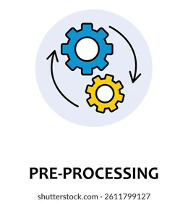
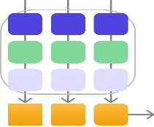



Algorithm & Deployment
Algorithm Used: Passive Aggressive Classifier
Steps:
Load and clean data (removing stopwords, lowercase, etc.)
Convert text to numerical form using TF-IDF Vectorizer
Train the classifier on 80% of data and test on 20%
Deploy model using joblib
Streamlit web interface to interact with the model
Data
Preprocessing
Vectorization
Model Training
Evaluation
Deployment

Slide 7
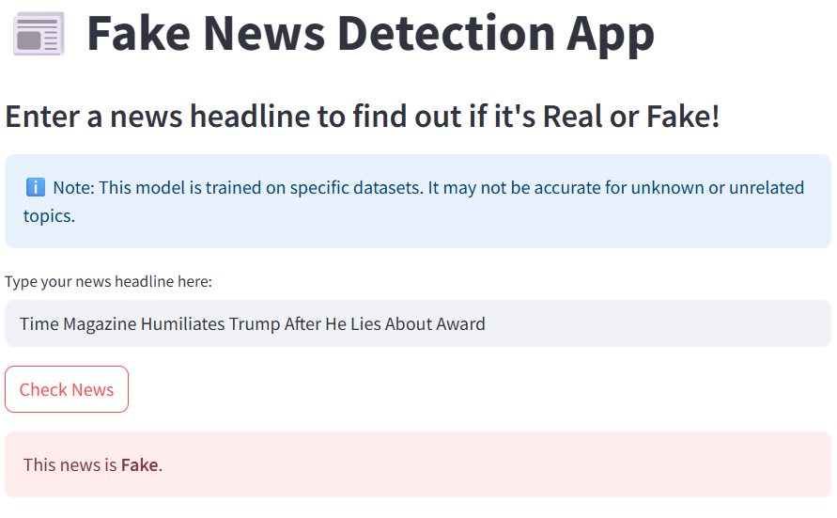
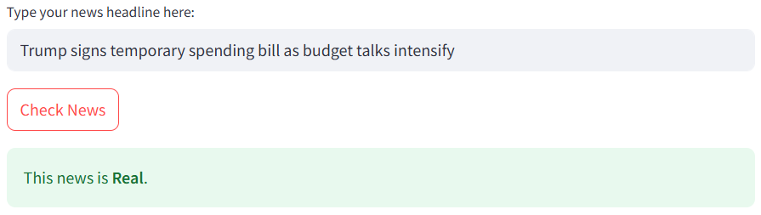
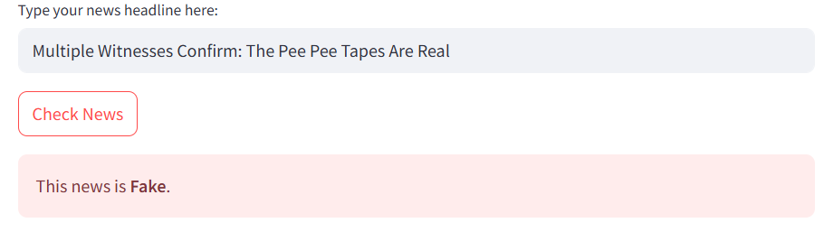
Result
Model Accuracy: ~94%
Streamlit Web Interface:

Slide 8

Handling Misclassification of News
"
Why did the model misclassify this headline? The model is trained on a limited dataset, primarily consisting of political news. As a result, it may misclassify headlines related to unfamiliar topics, such as science or space.
💡 Tip: You can test the model using these headlines to see how it performs
Real | Fake
White House, Congress prepare for talks on spending, immigration | Watch: Is This Proof Trump Is Unfit for Service?
Trump signs tax, government spending bills into law | White House Panics Knowing Flynn Is Going To Take Them Down
Senate leader McConnell sees a more collegial 2018 | Time Magazine Humiliates Trump After He Lies About Award

Slide 9
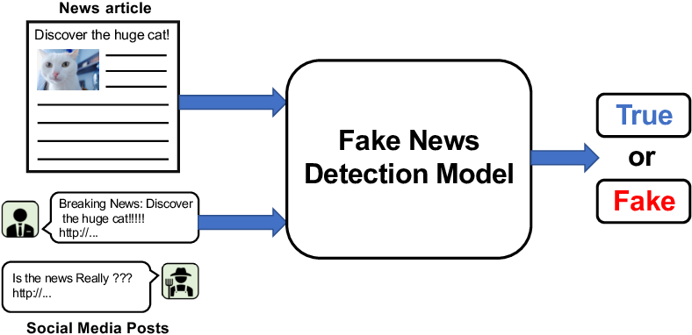
Conclusion
Functional Fake News Detection System built with good accuracy.
Successfully integrated AI, ML, and NLP techniques to detect fake news.
User-friendly web interface for quick feedback on news credibility.
Raises awareness about misinformation and its impact.

Slide 10
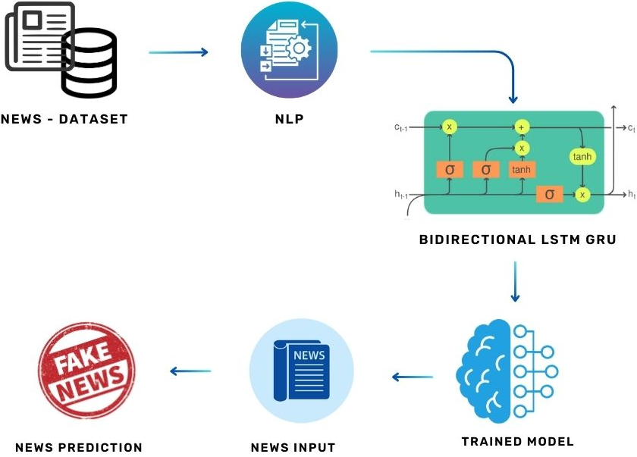
Future Scope
Expand dataset to include more topics: health, science, entertainment.
Improve accuracy by experimenting with other ML algorithms (e.g., SVM, BERT).
Enable multi-language support for broader usability
Add confidence scores to predictions and multi-language support.
Visual analytics and real-time news scanning can enhance functionality.

Slide 11

References
Datasets:
Kaggle - Fake.csv & True.csv
Technologies:
Scikit-learn Documentation
NLTK Documentation
Streamlit Documentation
GitHub Link:
https://github.com/950280/fake-news-detection

Slide 12

Thank you

